Slide 1
Community Health Research A. Gamble (they/them/theirs) Tisch Library, Tufts University

Slide 2
Hello!
I’m Alyson Gamble.
I am the Research Librarian for the Sciences at Tufts.
I’m here to help you find, analyze, and utilize research.
You can find me at go.tufts.edu/agamble

Slide 3
1. What is the Tisch Library?
More than “just books” …though we have those, too

Slide 4
Resources available at Tisch Library
Academic databases
Subject matter guides
Research assistance from librarians
These are not all the materials and services that are available to you. Check the Tisch Library website (tischlibrary.tufts.edu) or ask me about more.

Slide 5
If you can’t find a copy in the Tisch catalog, reach out.
You can also place an Inter-Library Loan (ILL) and the library will try to borrow it from another library.

Slide 7
2. Public health topics
Learning about a topic

Slide 8
Learning about a public health topic
Define/refine the description of your topic
Match topic to appropriate search tools
Construct (and revise) expert searches
New, original ideas or research
Commentary, analysis, discussion
Just the facts
Data collected
“Primary” journal articles
“Secondary” review articles, books, news/magazine articles
Encyclopedias, dictionaries

Slide 9
Refining your topic
What specifically interests you about this topic?
SGM mental health -> TGNC addiction
Why do you care about this topic?
Which communities are affected?

Slide 10
Refining your topic
Match your topic to a disciplinary database
https://researchguides.library.tufts.edu/CH30
Construct a search

Slide 11
As you develop a list of keywords, consider: Synonyms Related concepts Alternate spellings

Slide 12
Putting it all together
Connecting words: AND & OR
(keyword1 OR synonym) AND (keyword2 OR synonym)
Tip: Put quotation marks around phrases
Tip: Truncation, i.e., use an asterisk at the end of a word to capture all alternate endings (for example, use inject* to find inject, injection, injecting, etc.)

Slide 13
3. Populations
Learning about a population

Slide 14
Population data sources
Primary Data
Original project
Real-time
Messy, unprocessed
Secondary Data
Existing data
Processed & refined
Supplementary Data
Supports project & data reuse

Slide 15
Population data sources
Gray literature
Not controlled by commercial publishers
Technical reports, standards, patents, white papers, protocols, data sets …
Can be difficult to locate
Systematic Review Guide

Slide 16
Population data sources
Community level indicators
Search for “open data” + community
Community Health Guide

Slide 17
4. Evaluation
Evaluating your materials

Slide 18
ASPECT: a mnemonic for research
Authority
Who created this?
What are their credentials?
Do they have similar works?
Sources
Is this presented as fact?
Is there documentation/ sources?
Are these credible?
Purpose
Why was this created?
Who is the audience?
Does this meet your research needs?
Evenness
Is the material presented as objective?
Does the creator recognize their bias?
Coverage
How does this support other information you’ve found?
Is this information useful to you?
Timeliness
When was this published?
Is the time it was published appropriate for your needs?

Slide 19
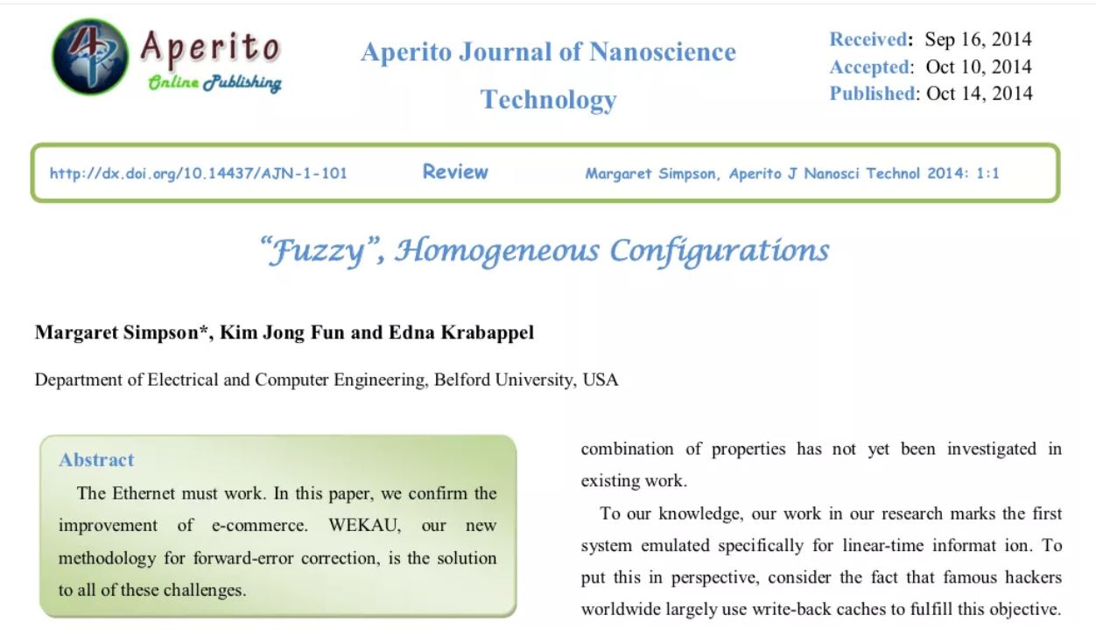

Slide 20
Evaluating using ASPECT
Authority
Fictional authors
Belford University was shut down for being a fake school in 2012.

Slide 21
5. Organization
Why citations matter & how to organize them

Slide 25
Citing Sources
Required to avoid plagiarism
Helps other recreate or understand your research
Builds on the scholarly conversation

Slide 26
Pro-Tips
Keep track of citations using a manager:
EndNote (proprietary, access while at Tufts)
Zotero (open source, stays with you)
Simplifies your work
Decreases information overload
Use any web clippers your reference manager provides

Slide 27
6. Putting it together
Class exercise

Slide 28
Working time!
Step 1: Use a database to find one peer-reviewed article on your public health topic
Download a full-text version of the article
Review the article reference list and identify two additional relevant sources within this list
Step 2: Use a database or the internet to find one source of evidence to help you learn more about a population group affected by your public heath problem
Step 3: Use a database or the internet to find one source of evidence to help you learn more the geography you intend to focus on
Notes:
Tips for searching:
*look to the works cited list of a good article to find more
*if you find an older article, use Google Scholar to see who has cited it
*starting with a review article can be helpful to get your bearings/understand context around an issue

Slide 29
Thank you!
Any questions?
You can find me at go.tufts.edu/agamble

Slide 30
Resource Credits
Several slides are sourced from librarian Nicole Bookout’s Spring 2019 workshop.
ASPECT is from Clark College Libraries.
“Fuzzy” Homogenous Configurations was reported in Vox and widely shared on academic Twitter.
Belford University is summarized on Wikipedia.
Citation meme is from Grad School Memes with Relatable Themes Facebook group.
Cat librarian meme is from Cliffside Park Public Library, Cliffside Park, New Jersey.

Slide 31
Design Credits
Special thanks to all the people who made and released these awesome resources for free:
Presentation template by SlidesCarnival
Photographs by Unsplash and The Gender Spectrum Collection
Fonts from Font Squirrel

