Slide 1
Community Health Research A. Gamble (they/them/theirs) Tisch Library, Tufts University

Slide 2
Hello!
I’m Alyson Gamble.
I am the Research Librarian for the Sciences at Tufts.
I’m here to help you find, analyze, and utilize research.
You can find me at go.tufts.edu/agamble
This is the first video in a 3-part series on Community Health Information.

Slide 3
1. What is the Tisch Library?
More than “just books” …though we have those, too

Slide 4
Resources available at Tisch Library
Academic databases
Subject matter guides
Research assistance from librarians
These are not all of the materials and services that are available to you, just the ones we have time to touch on today. Check the Tisch Library website (tischlibrary.tufts.edu) or ask me about more.

Slide 5
What are academic databases?
Places where you can find and access articles
Not always full-text
Sometimes these are bibliographic databases of citations that may or may not have the entire article
Different databases also have different coverage

Slide 6
If you can’t find a copy in the Tisch catalog, reach out.
You can also place an Inter-Library Loan (ILL) and the library will try to borrow it from another library.

Slide 7
Finding a database
Let’s work together to find the database PubMed on the Tisch Library site:
tischlibrary.tufts.edu

Slide 8
What are subject matter guides?
Librarian-created research guides
AKA LibGuides
Links to subject-specific resources
Databases
Books
…and more!

Slide 9
Finding a LibGuide
Let’s work together to find the LibGuide for our subject on the Tisch Library site:
tischlibrary.tufts.edu

Slide 10
What is research assistance?
Discussing your topic and needs with a librarian
Set up a consultation
Send a chat
Email a librarian
https://tischlibrary.tufts.edu/get-help/ask-us

Slide 12
2. I found something, now what?
Evaluating your materials

Slide 13
ASPECT: a mnemonic for research
Authority
Who created this?
What are their credentials?
Do they have similar works?
Sources
Is this presented as fact?
Is there documentation/ sources?
Are these credible?
Purpose
Why was this created?
Who is the audience?
Does this meet your research needs?
Evenness
Is the material presented as objective?
Does the creator recognize their bias?
Coverage
How does this support other information you’ve found?
Is this information useful to you?
Timeliness
When was this published?
Is the time it was published appropriate for your needs?

Slide 14
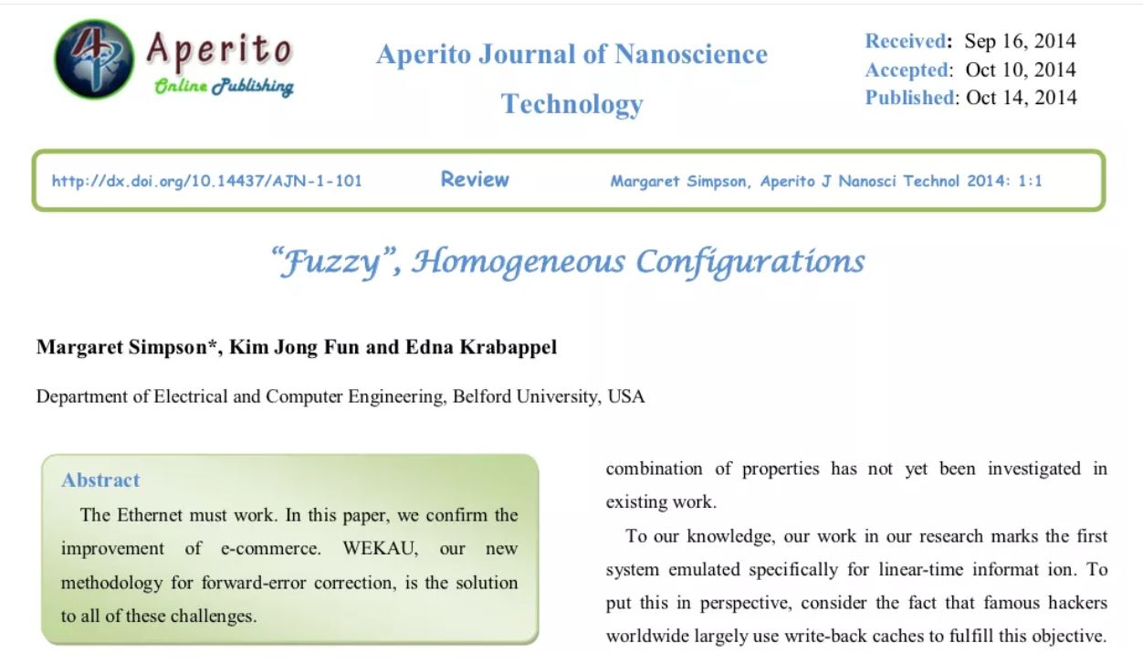

Slide 15
Evaluating using ASPECT
Authority
Fictional authors
Belford University was shut down for being a fake school in 2012.

Slide 16
Analyzing practice
Let’s work together to analyze an article you’ve found.

Slide 17
Analyzing Practice (~20 minutes)
Find an article using the database of your choice or use an article you already have available.
You will use ASPECT to evaluate this article using the worksheet.

Slide 18
3. This is great! How do I use it?
Why citations matter & how to make them

Slide 19
Citing Sources
Required to avoid plagiarism
Helps other recreate or understand your research
Builds on the scholarly conversation

Slide 20
Citation style
Citation style determines how you will cite material.
Most style guides require:
Author/s first and surname/s
Title of the material
Year it was published
Where it is located
Page numbers
Access point (e.g., URL, DOI)

Slide 21
Pro-Tips
Keep track of citations using a manager:
EndNote (proprietary, access while at Tufts)
Zotero (open source, stays with you)
Use any web clippers your reference manager provides

Slide 22
Citation practice
Let’s work together to create a citation.

Slide 23
Citation Practice (~5 minutes)
Cite the article you evaluated using the style guide/s required/suggested by your professor.

Slide 24
Thank you!
Any questions?
You can find me at go.tufts.edu/agamble

Slide 25
Design Credits
Special thanks to all the people who made and released these awesome resources for free:
Presentation template by SlidesCarnival
Photographs by Unsplash and The Gender Spectrum Collection
Fonts from https://design.ubuntu.com/font/

Slide 26
Resource Credits
ASPECT is from Clark College Libraries.
“Fuzzy” Homogenous Configurations was reported in Vox and widely shared on academic Twitter.
Belford University is summarized on Wikipedia.
Cat librarian meme is from Cliffside Park Public Library, Cliffside Park, New Jersey

