Slide 1
Food for All: Stakeholder Research A. Gamble (they/them/theirs) Tisch Library, Tufts University

Slide 2
Hello!
I’m Alyson Gamble.
I am the Research Librarian for the Sciences at Tufts.
I’m here to help you find, analyze, and utilize research.
You can find me at go.tufts.edu/agamble

Slide 3
1. Library Resources
More than “just books”
…though we have those, too!

Slide 4
Resources available at Tisch Library
Academic databases
Subject matter guides
Research assistance
These are not all materials and services available to you. Check the Tisch Library website (tischlibrary.tufts.edu) or ask
me about more.

Slide 5
If you can’t find a copy in the Tisch catalog, reach out.
You can also place an Inter-Library Loan (ILL) and the library will try to borrow it from another library.

Slide 6
What are subject matter guides?
Librarian-created research guides
AKA LibGuides
Links to subject-specific resources
Databases
Books
…and more!
BIO185 Guide

Slide 7
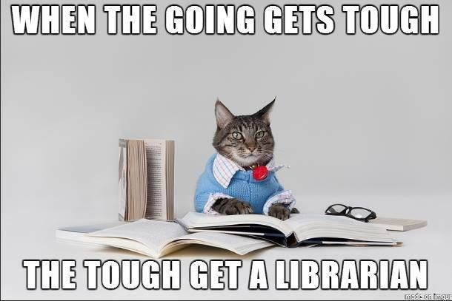

Slide 8
2. Stakeholders
Who cares about this issue? And why?

Slide 9
Updated: November 21, 2018 5:18 PM ET | Originally published: November 21, 2018 7:48 AM EST
July 21, 2020 | 5:14 AM
Notes:
An example….
Crop of interest: CORN
Issue: Herbicides, specifically Atrazine (one of the most widely used in the uSA) used on corn crops to prevent weeds… research on the effect of this herbicide on human & wildlife health
Controversy: researcher named Tyrone Hayes has found that exposure to Atrazine disrupts the reproductive system of frogs (Rachel Aviv’s new yorker piece), but Syngenta, the corporation who produces the herbicide Atrazine, has funded research that shows no effect on human or animal reproduction… (Jon Entine’s Forbes piece - accused Hayes of being attached to conspiracy theories, and of leading the “international regulatory community on a wild goose chase,” which “borders on criminal.”)
...Atrazine has been banned in the EU (high levels in groundwater that could not conclusively be proven to be safe by Syngenta)
Main takeaway:
Scientific research does not exist in a vacuum
Science & the way it is communicated is complex & influenced by political, social, and cultural environments. These factors shift scientific convo in surprisingly forceful ways
People have a stake in these issues!

Slide 10
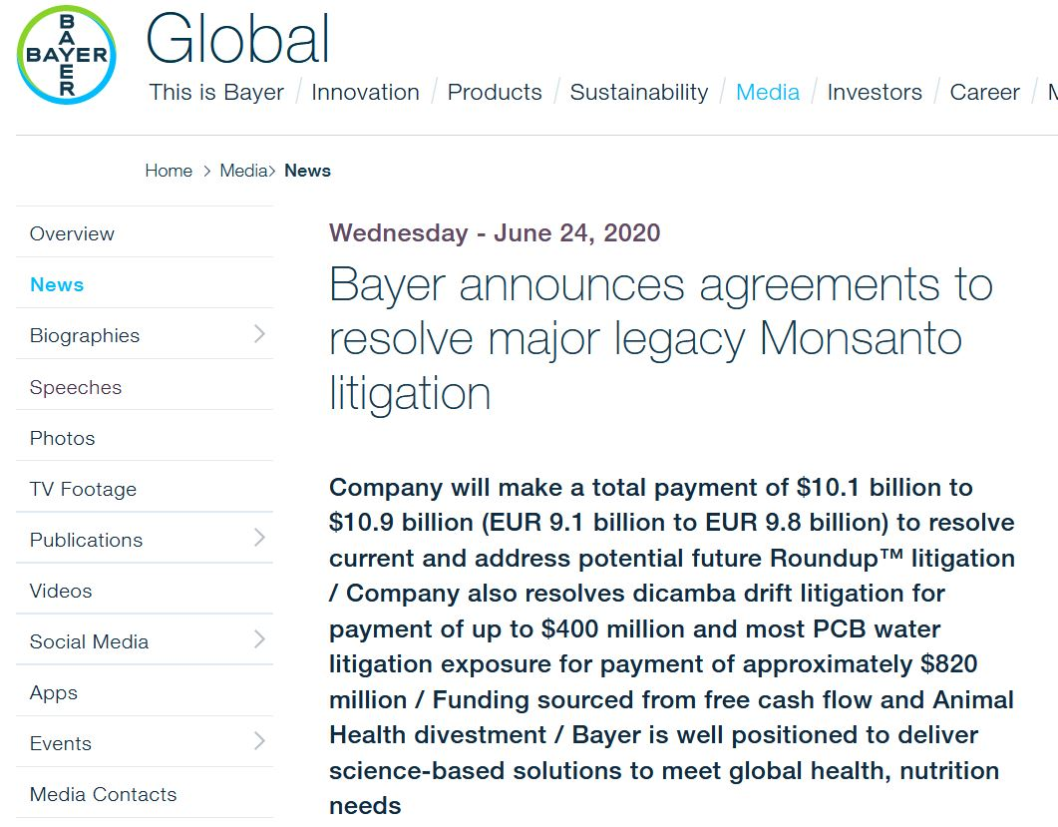

Slide 11
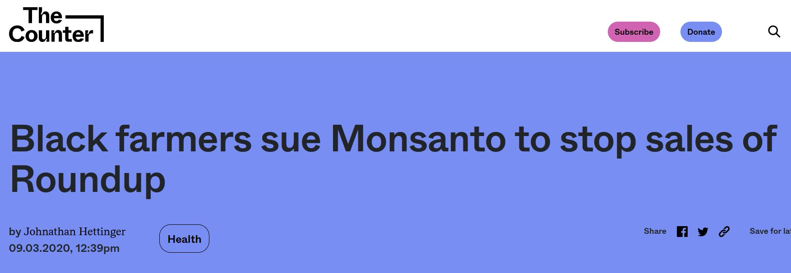

Slide 12
Concept Map Exercise (5min)
Who are the stakeholders in the Monsanto/Bayer controversies?

Slide 13
3. Information
Who is creating information?
& where can you find it?

Slide 14
Flow of scientific information
Email
Trade publications
Social Media
Government policy/regulations
Data is collected
Original ideas or research
Summary, analysis, discussion
Just the facts
News/interviews
Conferences
New protocol/product development
Public opinion
Notes:
Flow of scientific information. Overview of what happens to scientific data after it is collected.. how it is published and communicated
Research happens and data is collected….
Primary - The original research, ideas coming straight from the source itself is published in a JOURNAL – this is what you will likely be using most often when doing a lit review (hint: methods section and results section)
Secondary - Commentary, analysis & discussion of the original journal article (SECONDARY) … Review articles & systematic reviews, books published, interviews/newspapers & magazines, public opinion gov’t policy may arise based on the research
Tertiary - Just the facts (condensed), no new information or analysis is presented (TERTIARY)... Use them to look up bits of information or get a broad overview of a topic, these will be published years after original, primary research happens. Examples: dictionaries, encyclopedias, field guides... Hint: you don’t read these cover to cover
BUT, these are traditional modes of publication, much MORE discussion happens around scientific research & the information landscape gets MESSY:
Informal communication with colleagues via social media, blogs or personal websites, emails with colleagues….
Preliminary findings at conferences
So, where do the public’s voices voices fit into this workflow? Answer… they aren’t captured easily via traditional modes of publication (this makes certain voices harder than others to find)
*Take a few minutes to reflect on the stakeholders you identified previously and think about how their perspective is communicated. What source(s) of information could information capture that stakeholder’s perspective?*

Slide 15
Strategic matching of information need to source
Advanced search capabilities
Google Scholar
Open Web
Eg.
Web of Science
Factiva
Agricola
Environment Complete
Focus on our collections
Specialized databases
JumboSearch
Notes:
Web of Science
Search: TOPIC:(atrazine) AND TOPIC: (amphibian OR frog) AND TOPIC: (development)
Features: Funding agency (narrow by Syngenta), cited by, # times cited
Advanced Google search to find websites
Search: atrazine site:epa.gov, document: PDF (select document #2 from 2015, ctrl+F atrazine to find in document)
(x “trade publications”) / x farmer site:.org / x association / gov agencies…. USDA (& their national agricultural statistics service) or EPA
FACTIVA EXAMPLE – great for browsing. Industry tab (Agriculture – some examples of major trade orgs, industry snapshot/news/comparison/analysis - caution we don’t necessarily have access to all this stuff!). Search box: atrazine (industry -> agri -> oilseed/grain -> corn)

Slide 16
4. Evaluating
Evaluating information

Slide 17
ASPECT: a mnemonic for research
Authority
Who created this?
What are their credentials?
Do they have similar works?
Sources
Is this presented as fact?
Is there documentation/ sources?
Are these credible?
Purpose
Why was this created?
Who is the audience?
Does this meet your research needs?
Evenness
Is the material presented as objective?
Does the creator recognize their bias?
Coverage
How does this support other information you’ve found?
Is this information useful to you?
Timeliness
When was this published?
Is the time it was published appropriate for your needs?

Slide 18
Consider this question: Who knows the most about the use of pesticides on citrus fruits?
ASPECT: Authority
Notes:
Take a few moments to think about the answer to this question.
Does anyone want to share?

Slide 19
Types of Authority
Lived experience
Professional experience
Reporting or writing on an issue
Researching or studying the issue
How should we assess each of these manners of authority?
Notes:
Your answer fell within one of these “categories” of authority. Is one better than another? No. There are pros and cons to each. These are contextual. Everyone has an agenda, influencing the way information is created and presented to others… think about this while examining information AND while completing your assignments because you will have to pick a perspective and persuade…
Some people might have multiple “identities”
*what lens are you using to evaluate the info?
Example sources: *studying an issue: American Journal of Potato Research (a journal of the potato association of America) : https://link.springer.com/journal/12230
*professional experience: Potato Grower Magazine: https://www.potatogrower.com/ (or Potato Country or SPUDMAN – which actually has interesting profiles of people in the industry!!!!) – crop reports…. Recommended pesticide use schedule?
*lived experience: NYT interview with a potato grower? Someone who grew up on a potato farm?
*reporting on an issue: gov white paper: the impact of potato agriculture on the environment
THINK ABOUT WHERE THIS AUTHORITY COMES FROM… HOW DO WE ASSESS EACH OF THESE MANNERS OF AUTHORITY?

Slide 20
Assessing authority
Personal authority | Expert authority | Journalistic authority | Academic authority
Accuracy Evidence Why is this story being told?* | Credentials Employer Education Body of work Affiliations | Author: Credentials Body of work Reporting quality Evidence-based? Source: Reputation Purpose Editorial process? | Author: Credentials Education Body of work Cited evidence Source: Reputation Purpose Editorial process?
Notes:
*encouraging: ALWAYS ASK WHY this particular piece of the story is being told (what’s the motivation? Agenda? Persuasion/informational/analysis/commentary/selling something)…. Is there a counter-point or a trade-off?
*note there is bias in everything… even research. ask what is NOT being researched & why.

Slide 21
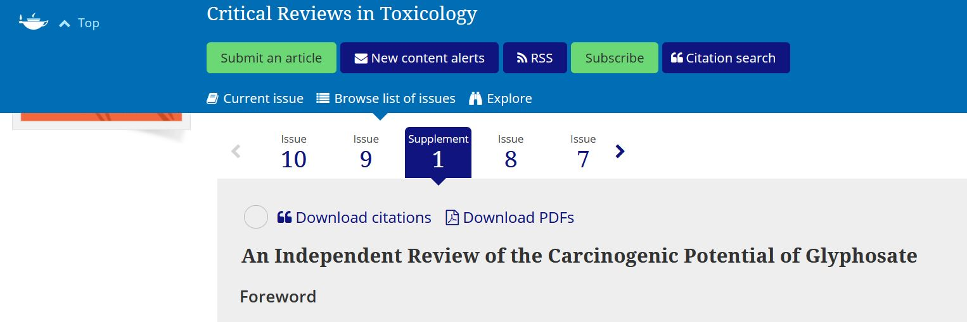
Evaluating using ASPECT
Evenness

Slide 22
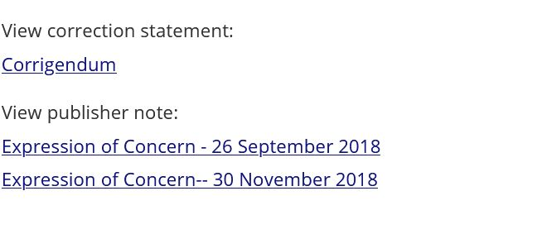
Evaluating using ASPECT
Evenness

Slide 23
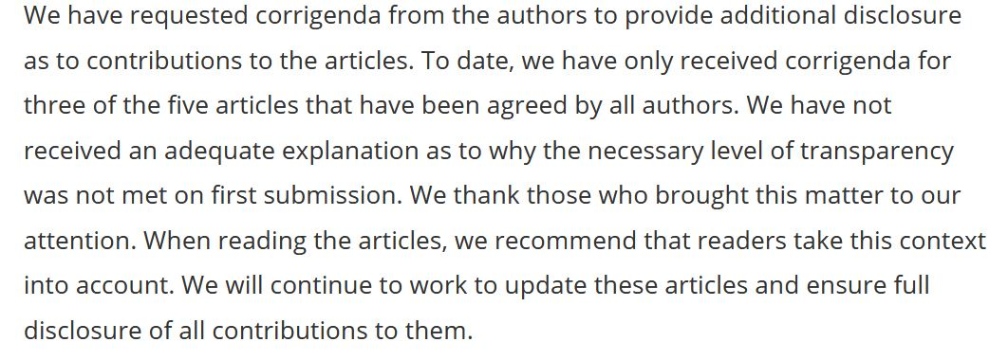
Evaluating using ASPECT
Evenness

Slide 24
Evaluating using ASPECT
Evenness
Corrigendum

Slide 25
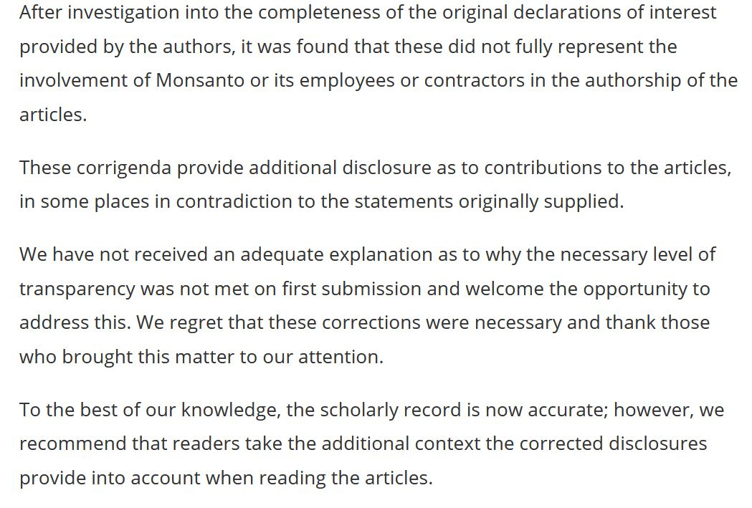
Evaluating using ASPECT
Evenness

Slide 26
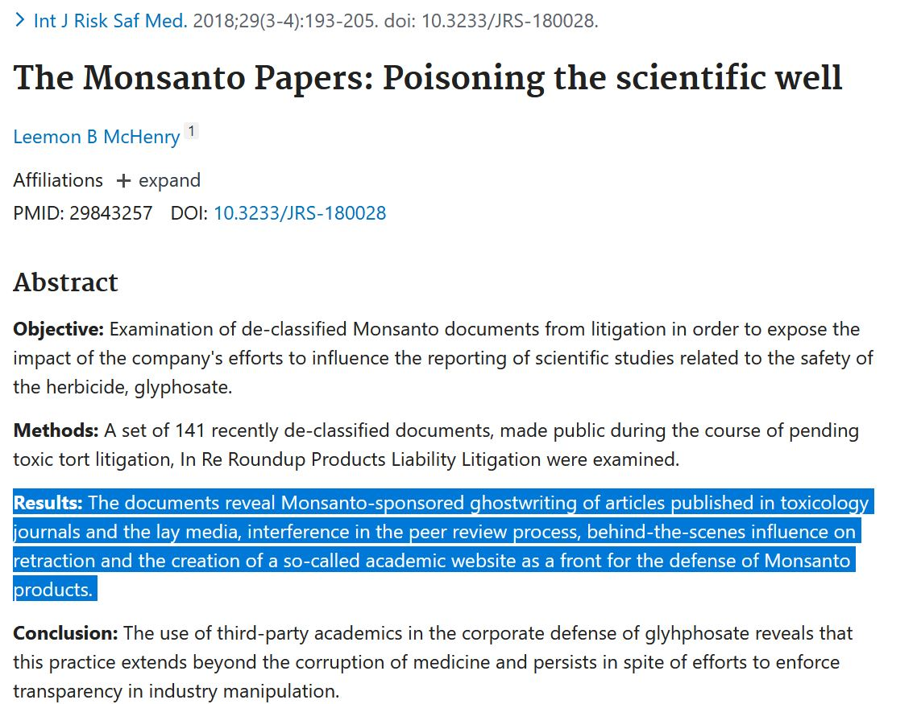
Evaluating using ASPECT
Evenness

Slide 27
Analyzing Practice (~10 minutes)
Find an article using the database of your choice or use an article you already have available.
Use ASPECT to evaluate this article using the worksheet.

Slide 28
5. Citations
Organizing your resources

Slide 29
Citing Sources
Required to avoid plagiarism
Helps other recreate or understand your research
Builds on the scholarly conversation

Slide 30
Pro-Tips
Keep track of citations using a manager:
EndNote (proprietary, access while at Tufts)
Zotero (open source, stays with you)
Use any web clippers your reference manager provides

Slide 31
Thank you!
Any questions?
You can find me at go.tufts.edu/agamble

Slide 32
Design Credits
Special thanks to all the people who made and released these awesome resources for free:
Presentation template by SlidesCarnival
Photographs by Unsplash and The Gender Spectrum Collection
Fonts from
http://www.1001fonts.com/
https://www.fontsquirrel.com/fonts/chivo

Slide 33
Resource Credits
ASPECT is from Clark College Libraries.
Several slides are sourced from librarian Nicole Bookout’s 2019 workshop.
Cat librarian meme is from Cliffside Park Public Library, Cliffside Park, New Jersey

