Slide 1
Darwinian Medicine Research A. Gamble (they/them/theirs) Tisch Library, Tufts University

Slide 2
Hello!
I’m Alyson Gamble.
I am the Research Librarian for the Sciences at Tufts.
I’m here to help you find, analyze, and utilize research.
You can find me at go.tufts.edu/agamble

Slide 3
1.
Exploring subjects
How to locate information

Slide 4
Resources available at Tisch Library
Academic databases
Subject matter guides
Research assistance from librarians
These are not all of the materials and services that are available to you, just the ones we have time to touch on today. Check the Tisch Library website (https://tischlibrary.tufts.edu/) or ask me about more.

Slide 5
What are academic databases?
Places where you can find and access articles
Not always full-text
Sometimes these are bibliographic databases of citations that may or may not have the entire article
Different databases also have different coverage

Slide 6
What are subject matter guides?
Librarian-created research guides
AKA LibGuides
Links to subject-specific resources
Databases
Books
…and more!
Biology LibGuide: https://researchguides.library.tufts.edu/Biology

Slide 7
If you can’t find a copy in the Tisch catalog, you can place an Inter-Library Loan (ILL) and the library will try to borrow it from another library.
You can also ask me for help. ☺

Slide 8
2. Finding evolutionary medicine materials
Limiting your search

Slide 9
Field ↔ Resources
specialized, interdisciplinary field =
specialized, interdisciplinary resources

Slide 10
Locating journals
Search for “Evolutionary Medicine” and related subjects
Note the journals where articles you find in larger databases
Search by author in databases and then search in the places they publish

Slide 11
Example Journal
Evolution, Medicine, & Public Health

Slide 12
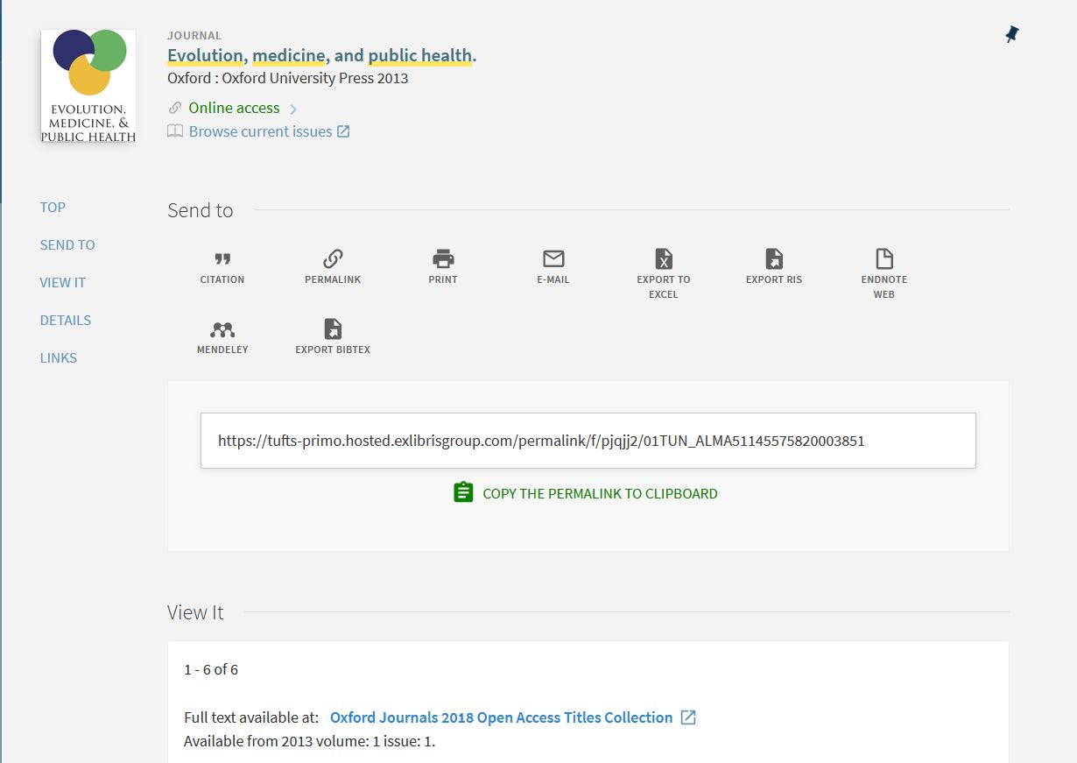
https://tufts-primo.hosted.exlibrisgroup.com/permalink/f/pjqjj2/01TUN_ALMA51145575820003851

Slide 13
Search terms
Subject Search
Use pre-defined subjects
Keyword searching
Use individual terms or phrases

Slide 14
3. Analyzing sources
Evaluating research

Slide 15
ASPECT: a mnemonic for research
Authority
Who created this?
What are their credentials?
Do they have similar works?
Sources
Is this presented as fact?
Is there documentation/ sources?
Are these credible?
Purpose
Why was this created?
Who is the audience?
Does this meet your research needs?
Evenness
Is the material presented as objective?
Does the creator recognize their bias?
Coverage
How does this support other information you’ve found?
Is this information useful to you?
Timeliness
When was this published?
Is the time it was published appropriate for your needs?

Slide 16
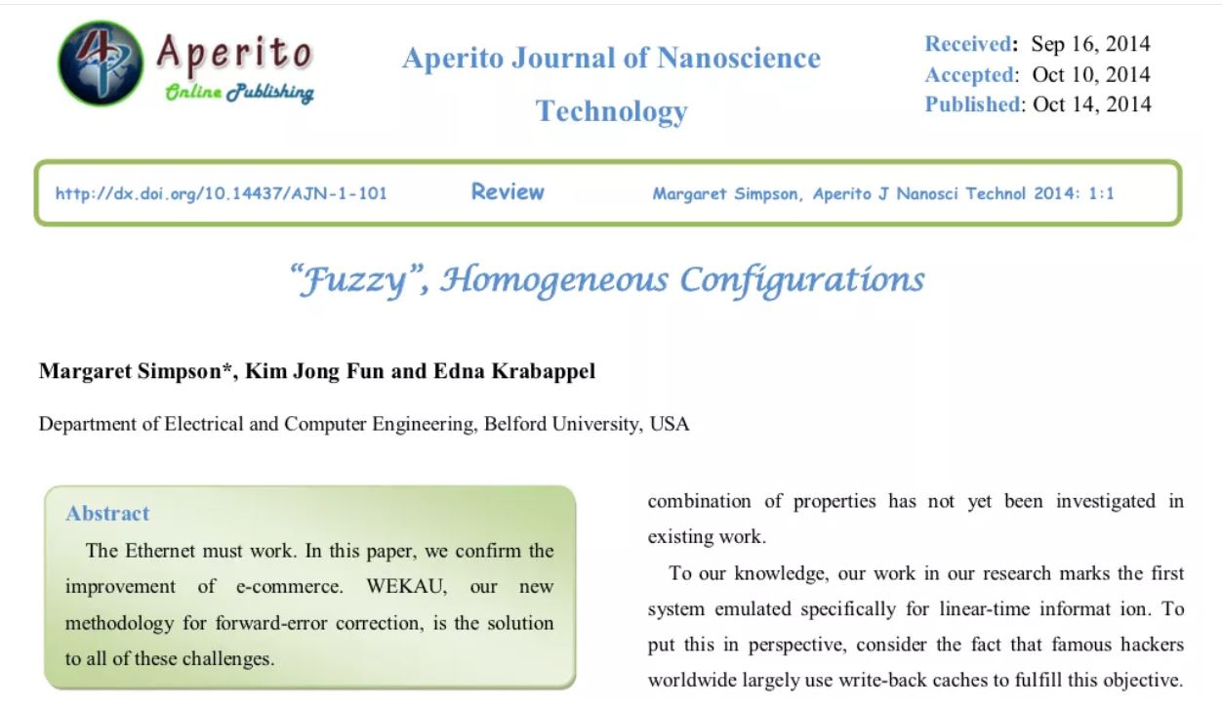

Slide 17
Evaluating using ASPECT
Authority
Fictional authors
Belford University was shut down for being a fake school in 2012.

Slide 18
4. Organizing resources
Keeping track of your research

Slide 19
Pro-Tips
Keep track of citations using a manager:
EndNote (proprietary, access while at Tufts)
Zotero (open source, stays with you)
Use any web clippers your reference manager provides

Slide 20
Thank you!
Any questions?
You can find me at go.tufts.edu/agamble

Slide 21
Design Credits
Special thanks to all the people who made and released these awesome resources for free:
Presentation template by SlidesCarnival
Photographs by Unsplash
Fonts from FontSquirrel

Slide 22
Resource Credits
ASPECT is from Clark College Libraries.
“Fuzzy” Homogenous Configurations was reported in Vox and widely shared on academic Twitter.
Belford University is summarized on Wikipedia.

